Slide 1

Heart disease prediction using machine learning
By Naveen Teja Reddy Majji

Slide 2
Introduction
Heart disease is a commonly occurring ailment that affects various individuals especially after a certain age where various factors come into play.
The detection of heart disease is a daunting task carried out using traditional diagnostics methods such as clinical evaluations and imaging.
These processes are inefficient and often proof to be time consuming and expensive with no tangible results obtained from the process.
Machine learning techniques can be used to solve this problem through the analysis of medical data to identify patterns and predict heart disease.
Our objective is to leverage machine learning techniques to enhance heart disease prediction accuracy to aid healthcare professionals in making data-driven decisions.

Slide 3
Data Description
The data selected for this particular analysis is heart disease data collected from patients tested and diagnosed based on various factors.
The data is obtained from Kaggle a public source and consists of fourteen different variables and over 1000 observations making it suitable.
The data preprocessing steps carried out in Rapid Miner include the checking and removal of missing values and adjustment of the data structure.
The data is first transformed through a numerical to binomial operator meant to transform the polynomial target variable to a binomial variable type.
The checking of missing values is done through the declaration operator and further filtered to retain data rows with complete data.

Slide 4
Univariate analysis
The first step in exploratory data analysis is the analysis of key variables through summary statistics and distribution plots.
The visualization of the distribution of the age variable reveals that most patients tested are over 35 years and most lie between 55 and 65 years.
The analysis of the cholesterol variable also shows a right skewed distribution with patients having moderate levels with a few exceptions noted.
The analysis of the max heart rate variable shows that the data is left skewed showing a high rate for most of the patients which is a concerning outcome.
The analysis of the data reveals that these three variables especially standout among the rest suggesting the need for further analysis.

Slide 5
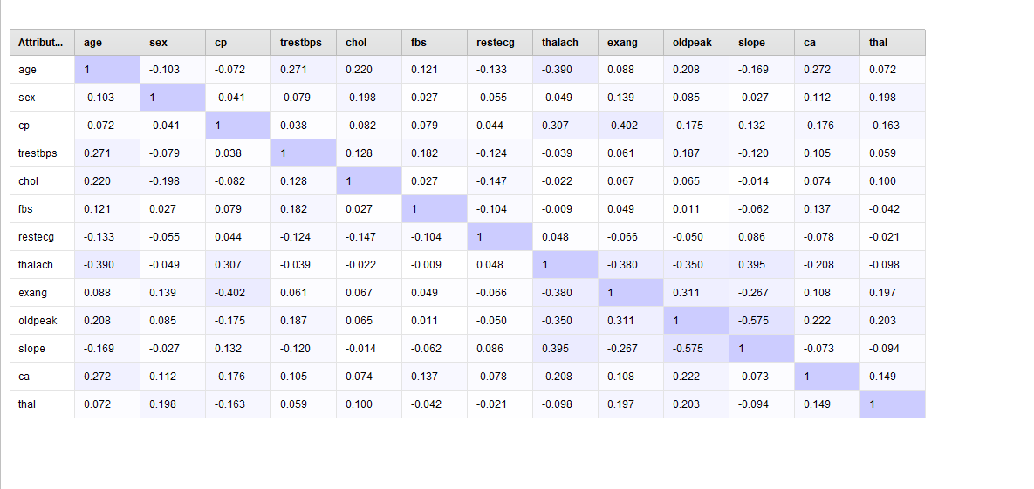
Bivariate analysis
The preliminary results obtained on the variables prompted further analysis to determine the relationships between variables.
The analysis to determine cholesterol distribution among variables showed that more diagnosed patients had high cholesterol.
The correlation analysis revealed existence of weak relationships meaning no multicollinearity in the data.
The outlier analysis further showed that that the data is suitable with no outliers in any column.

Slide 6
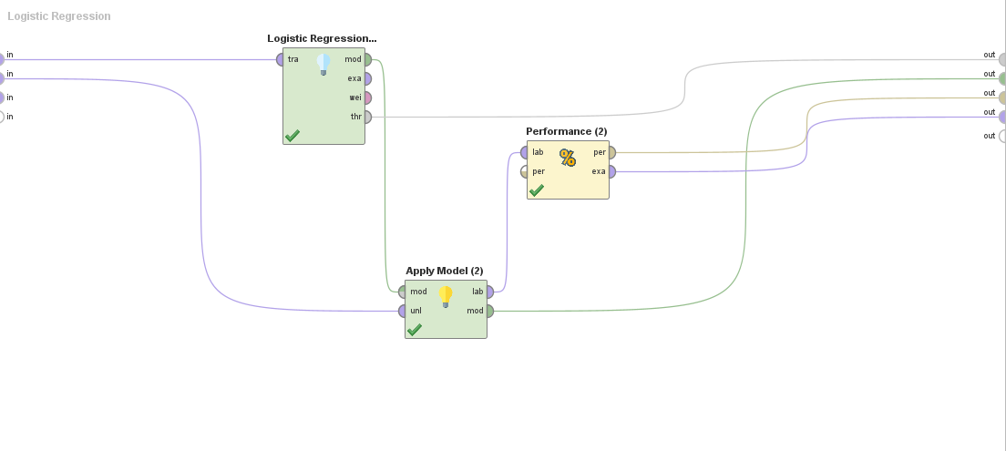
Logistic Regression
Logistic regression was the first model applied on the data to create a baseline for the analysis.
The training process involves using the split data through normalization of numerical features to improve convergence.
The model was trained using the maximum likelihood estimation method with the use of regularization to prevent overfitting.
The apply model and performance model operators were then used to evaluate the results.

Slide 7
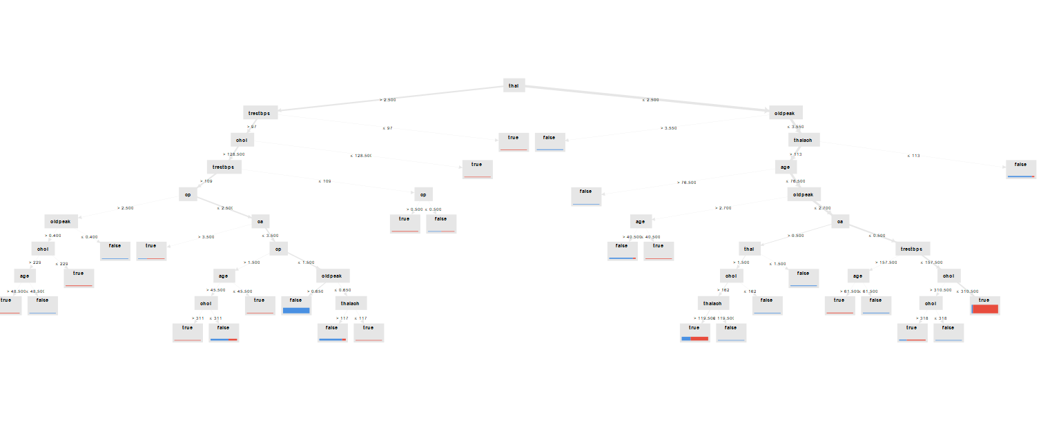
Decision Tree
The decision tree model was applied by splitting the data based on feature conditions.
The training process involved selection of the best features at each index using Gini index.
Consequent processes involve the recursive splitting of data until a stopping criteria such as end of the sample is reached.
The tree is pruned using hyperparameters such as tree depth to prevent overfitting.

Slide 8
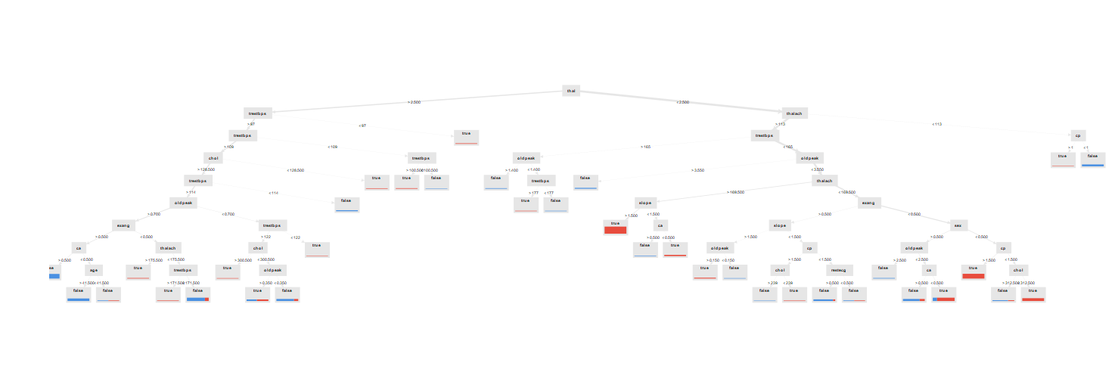
Random forest
The random forest model is selected as the only ensemble model among the bunch.
The model is created using a combination of multiple decision trees for high accuracy and robustness.
The bootstrap sampling method is used in this case to train each tree on a random subset of features.
The aggregate predictions from all the trees are used as the majority vote ensuring high accuracy of the classification result.

Slide 9
Performance Analysis
The analysis of the performance metrics of the three models reveal interesting insights on their performance and most preferred model.
The logistic regression model performed fairly well with an accuracy score of 84.38% while the decision tree model had an accuracy of 85.55%.
The random forest model out performed all the other models achieving an accuracy of 94.53% which is an indication of the model’s ability to capture complex patterns in data.
The results of the confusion matrices for the models show similar results with random forest exhibiting extraordinary performance with fewer misclassifications.
The model has a high recall and specificity which are over 90% indicating the existence of minimal false positives and negatives.

Slide 10
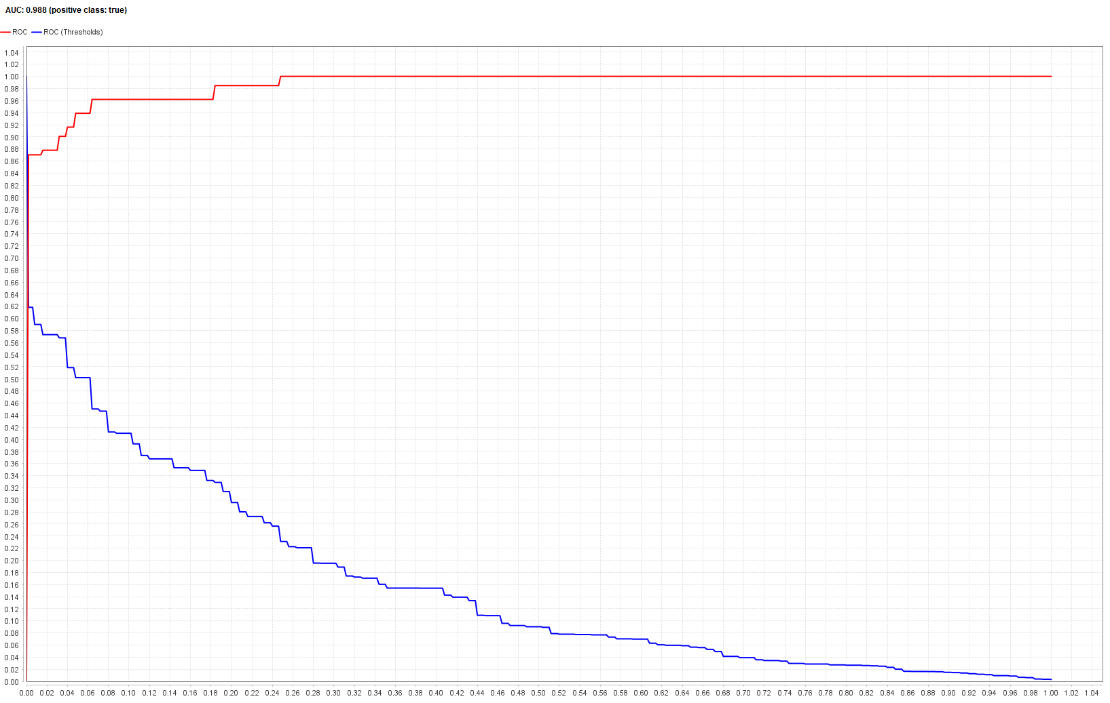
ROC and AUC
The ROC and AUC of the random forest model particularly stands out.
The random forest model is a near-perfect model with a sharp rise in the curve to (0,1) as shown in the image.
The curve is much closer to the top-left corner which is an indication of high model performance.
The AUC of the model is 0.988 which is closest to one indicating perfect classification.

Slide 11
Conclusion
This research is quite effective in demonstrating the benefits and power of machine learning techniques in the prediction of heart disease.
The research compares the logistic regression model, decision tree model and random forest model showcasing their prowess.
The performance of the random forest reveals the power of ensemble models in capturing complex patterns such as those common in medical data.
Such models offer powerful predictive capabilities for strong foundations in early diagnosis and risk assessment in the medical field.
The research reveals their usefulness in business and healthcare perspectives to support informed decision making and reduce misdiagnosis.

